Slide 1

Supermarket Sales prediction
AVULA.MADHU

Slide 2
Agenda
Problem statement
Features of dataset
Exploratory data analysis
Data visualisation
Fitting the machine learning models
Conclusion

Slide 3
Problem statement
Prediction of sales.
we have to predict the sales for supermarkets located in different cities.

Slide 4
Features of dataset
Item_identifier:-unique product ID
Item_weight:-weight of products
Fat content:-specifies whether the product is low on fat or not
Visibility:-percentage of total display area of all product in a store allocated to the particular product
Item_type:-the category to which the product belongs
MRP: maximum retail price(listed price) of the products
Outlet identifier:-unique store ID
Establishementyear:-year of the establishment of the outlet
Outletsize:-the size of the store in terms of ground area covered
Location type:- the type of city in which the store is located
Outlettypespecifies whether the outlet is just a grocery store or some sort of supermarket
outletsales:-(target variable) sales of the product in the particular store

Slide 5
Exploratory data analysis
Import use full libraries
Read the csv file
Find the shape of the dataset(8523,12)
Find the null values replace the null values mean and mode
Checking duplicates are not.
Here checking outliers and removing the outliers
Doing the label encoding

Slide 6
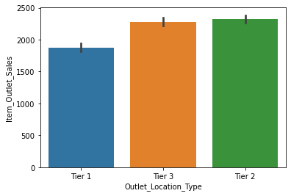
Outlet location type and sales
Here the highest sales tier2
2300 sales
lowest sales in tier 1 in 1800

Slide 7
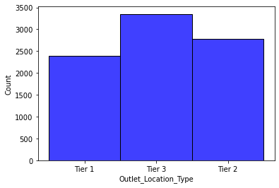
Outlet location type and count
Here the tier 3 outlet location type is higher count is 3400.
Tier1 is lowest outlet location type 2400.

Slide 8
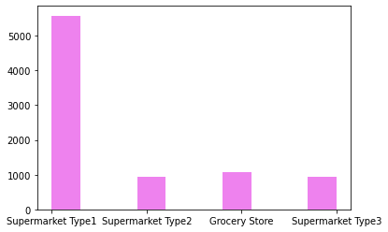
Outlet type and count
Supermarket type1 is highest count.
Lowest supermarket type2 count is 1000.

Slide 9
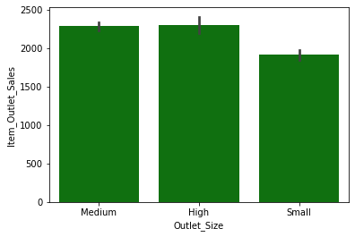
Outlet size and sales
Here outlet size is medium and high is 2300.
0utlet size is small here sales is 2000.

Slide 10
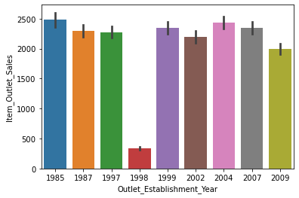
Outlet establishment year and sales
Outlet establishment year 1985 is highest sales is 2500.
Outlet establishment year 1998 sales is lowest.

Slide 11
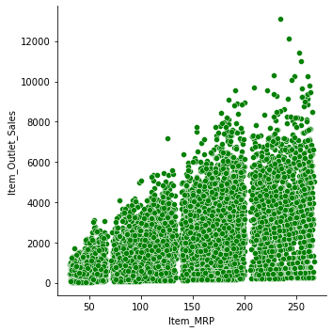
Item mrp and sales
Here highest mrp is 250 here sales Is 12000.
Lowest 50 and sales is 4000.

Slide 12
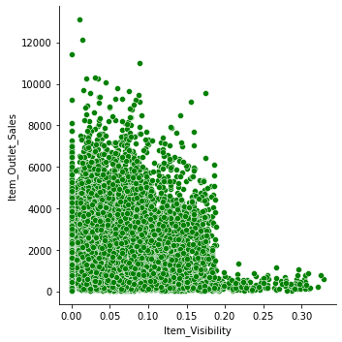
Item visibility and sales
Here highest visibility 0.00 and sales is 12000.
Lowest item visibility and sales is 2000.

Slide 13
Regression train and test values

Slide 14
conclusion
Here the using the features predicting the sales and easily analysing the data using visualisation.

